Slide 1

Perancangan Sistem Pemrograman
Mapping Designs to Code
Prepared by Frans Panduwinata, S.Kom, M.T

Slide 2

Visibility Between Objects
For a sender object to send a message to a receiver object, the sender must be visible to the receiver.
The sender must have some kind of reference or pointer to the receiver object.
When creating a design of interacting objects, it is necessary to ensure that the necessary visibility is present to support message interaction.

Slide 3
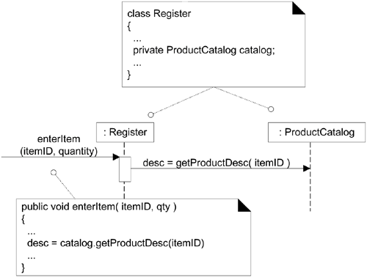
Visibility Between Objects (cont)
For EXAMPLE:
The getProductDescription message sent from a Register to a ProductCatalog implies that the ProductCatalog instance is visible to the Register instance.

Slide 4
What is Visibility?
Visibility is the ability of an object to "see" or have a reference to another object.
There are four common ways that visibility can be achieved from object A to object B:
  Attribute visibility B is an attribute of A.
  Parameter visibility B is a parameter of a method of A.
  Local visibility B is a (non-parameter) local object in a method of A.
  Global visibility B is in some way globally visible.

Slide 5
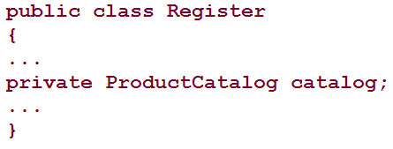
Attribute Visibility
Attribute visibility from A to B exists when B is an attribute of A.
For EXAMPLE:
  In a Java class definition for Register, a Register instance may have attribute visibility to a ProductCatalog, since it is an attribute of the Register.

Slide 6
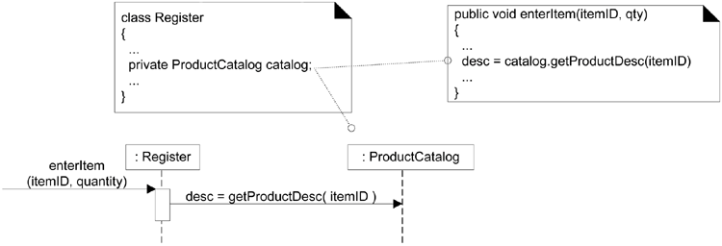
Attribute Visibility (cont)
For EXAMPLE: (cont)
  This visibility is required because in the enterItem diagram shown below, a Register needs to send the getProductDescription message to a ProductCatalog:

Slide 7
Parameter Visibility
Parameter visibility from A to B exists when B is passed as a parameter to a method of A.
It is a relatively temporary visibility because it persists only within the scope of the method.

Slide 8
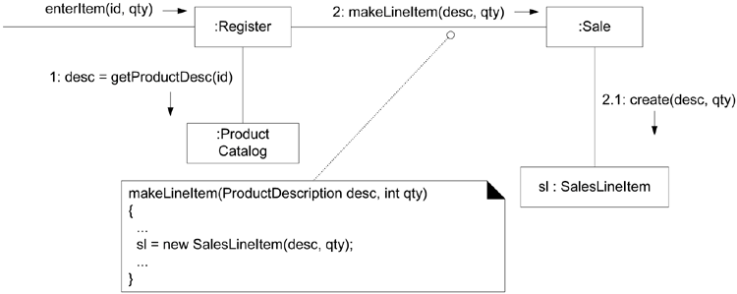
Parameter Visibility (cont)
EXAMPLE:
  When the makeLineItem message is sent to a Sale instance, a ProductDescription instance is passed as a parameter.
  Within the scope of the makeLineItem method, the Sale has parameter visibility to a ProductDescription.

Slide 9
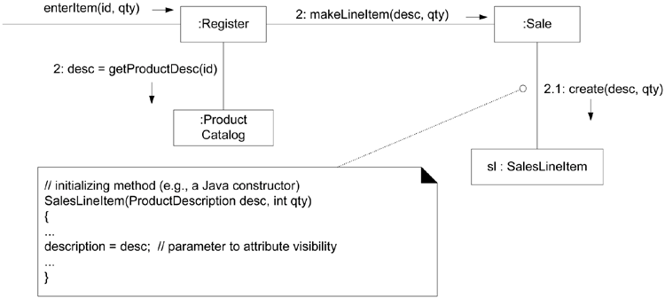
Parameter Visibility (cont)
It is common to transform parameter visibility into attribute visibility. For EXAMPLE:
  When the Sale creates a new SalesLineItem, it passes the ProductDescription in to its initializing method.
  Within the initializing method, the parameter is assigned to an attribute, thus establishing attribute visibility.

Slide 10
Local Visibility
Local visibility from A to B exists when B is declared as a local object within a method of A.
It is a relatively temporary visibility because it persists only within the scope of the method.
Two common means by which local visibility is achieved are:
  Create a new local instance and assign it to a local variable.
  Assign the returning object from a method invocation to a local variable.

Slide 11
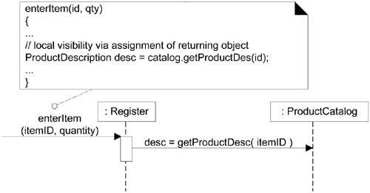
Local Visibility (cont)
It is also common to transform locally declared visibility into attribute visibility.
An EXAMPLE of the second variation (assigning the returning object to a local variable) can be found in the enterItem method of class Register.

Slide 12
Global Visibility
Global visibility from A to B exists when B is global to A.
It is a relatively permanent visibility because it persists as long as A and B exist.
One way to achieve global visibility is to assign an instance to a global variable, which is possible in some languages, such as C++, but not others, such as Java.

Slide 13
Programming and the Development Process
Development should be based on a significant amount of analysis and design before coding begins.
Core applications are best determined in a formal investigation and design process rather than by a “rush to code.”
The creation of code in an OO programming language is not part of OOA/D; it is an end goal.

Slide 14
Creativity and Change During the Construct Phase
The generation of the code is a relatively mechanical translation process.
Realistically, the results generated during design are an incomplete first step; during programming and testing myriad changes will be made and detailed problem will be uncovered and resolved.
Consequently, expect and plan for change and deviation from design during construction and testing phase.

Slide 15
Mapping Designs to Code
Implementation in an object-oriented language requires writing source code for:
  Class and interface definitions
  Method definitions

Slide 16
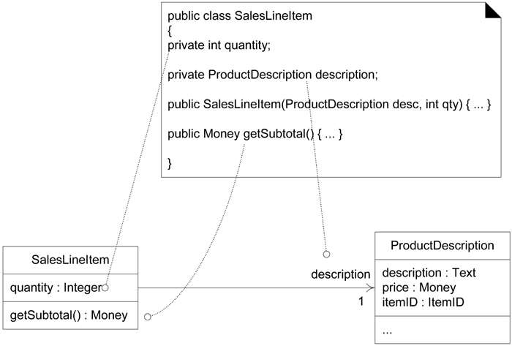
Creating Class Definitions from DCDs
From the Design Class Diagram (DCD), a mapping to the attribute definitions and method signatures for the Java definition of SalesLineItem is straightforward, as shown in figure below.

Slide 17
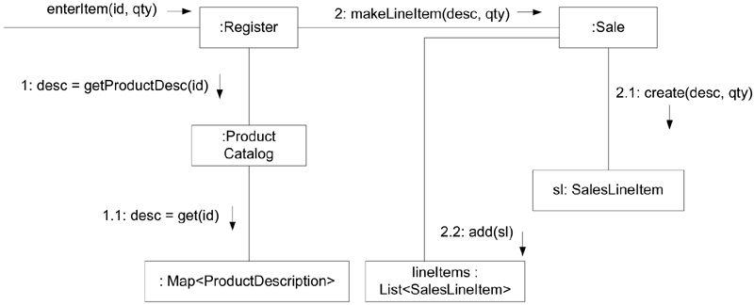
Creating Methods from Interaction Diagrams
The sequence of the messages in an interaction diagram translates to a series of statements in the method definitions.
The enterItem interaction diagram.

Slide 18
Creating Methods from Interaction Diagrams (cont)
The enterItem message is sent to a Register instance; therefore, the enterItem method is defined in class Register.
public void enterItem(ItemID itemID, int qty)
Message 1:
A getProductDescription message is sent to the ProductCatalog to retrieve a ProductDescription.
ProductDescription desc = catalog.getProductDescription(itemID);
Message 2:
The makeLineItem message is sent to the Sale.
currentSale.makeLineItem(desc, qty);

Slide 19
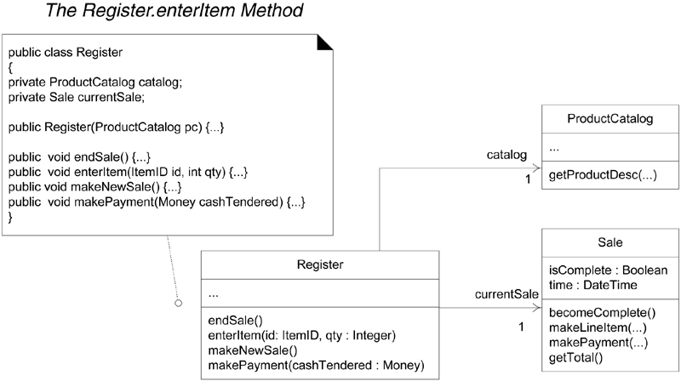
Creating Methods from Interaction Diagrams (cont)
The Register class.

Slide 20
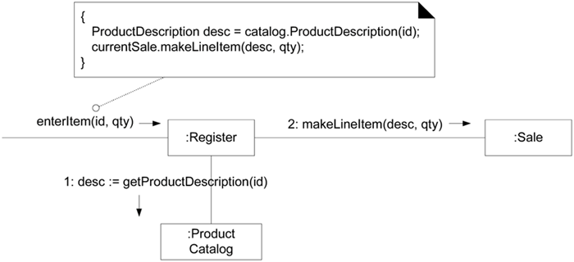
Creating Methods from Interaction Diagrams (cont)
The enterItem method.

Slide 21
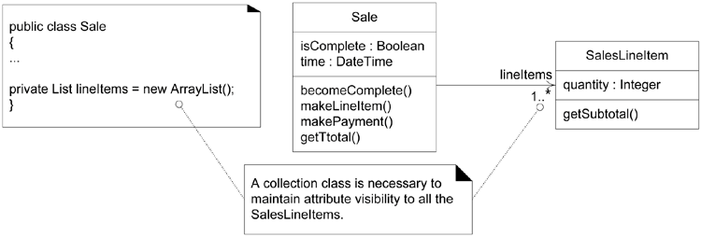
Collection Classes in Code
One-to-many relationships are common. For EXAMPLE, a Sale must maintain visibility to a group of many SalesLineItem instances.
In OO programming languages, these relationships are usually implemented with the introduction of a collection object, such as a List or Map, or even a simple array.

Slide 22
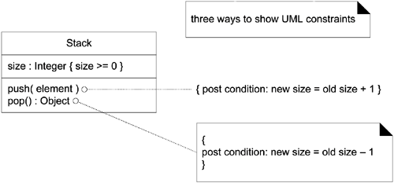
Exceptions and Error Handling
In terms of the UML, exceptions can be indicated in the property strings of messages and operation declarations
A UML constraint is a restriction or condition on a UML element. It is visualized in text between braces;
For EXAMPLE: { size >= 0 }.

Slide 23
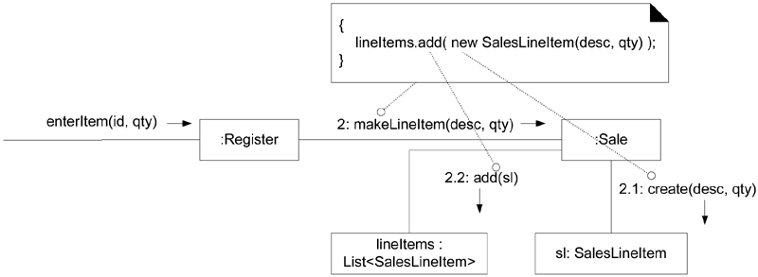
Defining the Sale.makeLineItem Method
The makeLineItem method of class Sale can also be written by inspecting the enterItem collaboration diagram.

Slide 24
Order of Implementation
Classes need to be implemented from least-coupled to most-coupled.
For EXAMPLE, possible first classes to implement are either Payment or ProductDescription; next are classes only dependent on the prior implementations ProductCatalog or SalesLineItem.

Slide 25
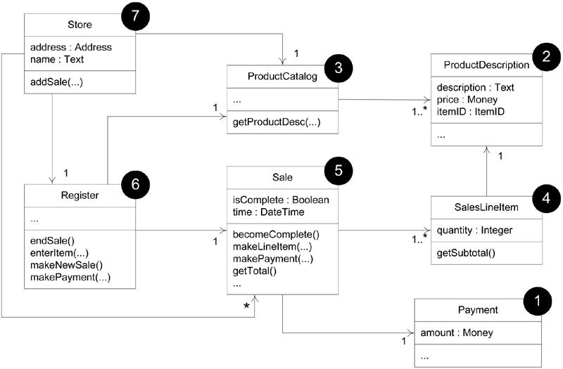
Order of Implementation (cont)
Possible order of class implementation and testing.

Slide 26
Java: Real-world Objects
Two characteristics :
  State
  Behavior
EXAMPLE:
A dog:
  State: name, color, breed, hungry
  Behavior: barks, bites, runs, jumps

Slide 27
Java: Software Objects
Modeled after real-world objects.
Maintains states in variables and
Implements behaviors with methods

Slide 28
Java: A Bicycle Model
10 mph
90 rpm
change gears
5th gear
brake
Gear Implementation
change cadence

Slide 29
Java: Encapsulation
Packaging an object’s variables within the protective custody of its methods.
Typically, used to hide unimportant implementation details from other objects.
Benefits:
  Modularity
  Information hiding

Slide 30
Java: Messages
Software objects interact and communicate with each other using messages.
Object A wants object B to perform one of B’s methods = object A sends a message to object B.
Component of a Message:
  The object to whom the message is addressed
  The name of the method to perform
  Any parameters needed by the method

Slide 31
Java: Messages (cont)
changeGears message
changeGears(lowerGear)
YOUR BICYCLE
YOU

Slide 32
Java Structure
Each class represents an object
A class is documented in a file
Java source code extension: *.java

Slide 33
A Java Source File
class Class_Name {
variable declarations;
method declarations { … }
}
Bicycle Class:
class Bicycle {
int gear;
int cadence;
…..
void changeGears (int gear ) {
……… ;
}
……
}

Slide 34
What is Java?
A programming language and a platform.
Simple
Object-oriented
Distributed
Interpreted
Robust
Secure
Architecture-neutral
Portable
High-performance
Multithreaded
Dynamic

Slide 35
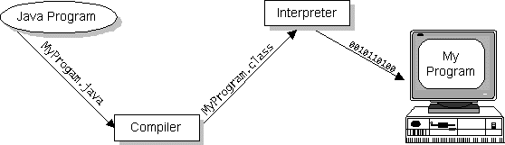
Java Program
Java program is both compiled and interpreted.

Slide 36
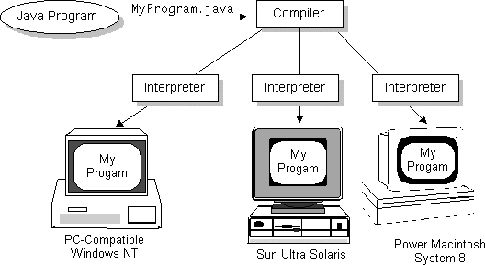
Java Program (cont)

Slide 37

The Java Platform
Two components of the Java platform:
  The Java Virtual Machine (Java VM)
  The Java Application Programming Interface (Java API)
A Platform Independent Environment

Slide 38
Java: Operand
Number of Operand
  Unary Operators ++
  Binary Operators =
  Ternary Operators ?:
Location of Operand
  Prefix Notation
operator op
  Postfix Notation
op operator
  Infix Notation
op1 operator op2
expr ? op1 : op2

Slide 39
Java: Arithmetic Operators
Operator | Use | Description
+ | op1 + op2 | Adds op1 and op2
- | op1 - op2 | Subtracts op2 from op1
* | op1 * op2 | Multiplies op1 by op2
/ | op1 / op2 | Divides op1 by op2
% | op1 % op2 | Computes the remainder of dividing op1 by op2

Slide 40
Java: Prefix & Postfix Version
Operator | Use | Description
++ | op++ | Increments op by 1; evaluates to value before incrementing
++ | ++op | Increments op by 1; evaluates to value after incrementing
-- | op-- | Decrements op by 1; evaluates to value before decrementing
-- | --op | Decrements op by 1; evaluates to value after decrementing

Slide 41
Java: Relational and Conditional
Operators
Operator | Use | Return true if
> | op1 > op2 | op1 is greater than op2
>= | op1 >= op2 | op1 is greater than or equal to op2
< | op1 < op2 | op1 is less than op2
<= | op1 <= op2 | op1 is less than or equal to op2
== | op1 == op2 | op1 and op2 are equal
!= | op1 != op2 | op1 and op2 are not equal

Slide 42
Java: Binary Conditional Operators
Operator | Use | Return true if
&& | op1 && op2 | op1 and op2 are both true, conditionally evaluates op2
|| | op1 || op2 | either op1 or op2 is true, conditionally evaluates op2
! | !op | op is false

Slide 43
Java: Assignment Operators
Operator | Use | Equivalent to
+= | op1 += op2 | op1 = op1 + op2
-= | op1 -= op2 | op1 = op1 - op2
*= | op1 *= op2 | op1 = op1 * op2
/= | op1 /= op2 | op1 = op1 / op2
%= | op1 %= op2 | op1 = op1 % op2
&= | op1 &= op2 | op1 = op1 & op2
|= | op1 |= op2 | op1 = op1 | op2
^= | op1 ^= op2 | op1 = op1 ^ op2
<<= | op1 <<= op2 | op1 = op1 << op2
>>= | op1 >>= op2 | op1 = op1 >> op2

Slide 44
Java: Dot Operator
Dot operator is used to select a method that is applied to an object.
double theArea = theCircle.area( );

Slide 45
Java: Declaration of Objects
Declaring a reference variable is simply providing a name that can be used to reference an object that is stored in memory.
EXAMPLE:
Button b;
b.setLabel(“No”);
p.add( b );
Button b;
b = new Button( );
b.setLabel(“No”);
p.add( b );
calling a method from
a Button object which
doesn’t exist
Wrong
Right

Slide 46
Java: Reference Variables
point3 = point2;
(0, 0)
1000
(0, 0)
point1
1024
(0, 0)
(at 1000)
3200
point2 = 1024
3600
point1 = 1000
point2
(0, 0)
5124
point3 = 1000
(at 1024)
point3

Slide 47
Java: Reference Variables (cont)
point3 = point2;
(0, 0)
1000
(0, 0)
point1
1024
(0, 0)
(at 1000)
3200
point2 = 1024
3600
point1 = 1000
point2
(0, 0)
5124
point3 = 1024
(at 1024)
point3

Slide 48
Java: Meaning of =
Wrong:
Button noButton = new Button(“No”);
Button yesButton = noButton;
yesButton.setLabel(“Yes”);
p.add(noButton);
p.add(yesButton);
Right:
Button noButton = new Button(“No”);
Button yesButton = new Button( );
yesButton = noButton;
yesButton.setLabel(“Yes”);
p.add(noButton);
p.add(yesButton);

Slide 49
Java: The Meaning of ==
EXAMPLE:
Button a = new Button(“Yes”);
Button b = new Button(“Yes”);
Button c = b;
…
if (b == c) { … }

Slide 50
Java: Strings
EXAMPLE:
String empty = “”;
String message = “Hello”;
String repeat = message;
“this” + “that”;
“abc” + 5
“a” + 1 + 2

Slide 51
Java: Comparing Strings
EXAMPLE:
String first = “message1”;
String second = “message2”;
String third = “message1”;
return first == third;
return first.equals(third);
return first.compareTo(third);

Slide 52
Java: Other String Methods
EXAMPLE:
String greeting = “hello”;
int len = greeting.length( );
char ch = greeting.charAt(1);
String sub = greeting.substring(2, 4);

